Slide 1
Training Presentation
By
Shadab Ahmad Khan

Slide 2
Contents
What is Java
Basic rules of Java
OOP Principle
Exception Handling
Mulyithreading
Input/output
Collections in Java
Swing Overview
Architecture/ Hierarchy of Swing
Top Level Containers/ Middle Level Containers
Layout Managers
Menus
Bounded Range Components
Java 2D API
Basic Shapes
Affine Transformation

Slide 3
What Is Java?
History
Characteristics of Java

Slide 4
History
James Goslin , Mike Sheridan, and Patrick Naughton initiated the Java language project in June 1991.Java was originally designed for interactive television, but it was too advanced for the digital cable television industry at the time . The language was initially called Oak after an oak tree that stood outside Gosling's office; it went by the name Green later, and was later renamed Java, from Java coffee , said to be consumed in large quantities by the language‘s.

Slide 5
Java versions
Version | DoB | Code Name | Packages | Classes
JDK 1.0 | 23/01/1996 | Oak | 8 | 212
JDK 1.1 | 19/02/1997 | ------- | 23 | 504
J2SE 1.2 | 08/12/1998 | Playground | 59 | 1520
J2SE 1.3 | 08/05/2000 | Kestrel | 76 | 1842
J2SE1.4 | 06/02/2002 | Merlin | 135 | 2991
J2SE 5.0 | 30/09/2004 | Tiger | 166 | 3279
JavaSE 6.0 | 11/12/2006 | Mustang | 203 | 3793
JavaSE 7.0 | 28/07/2011 | Dolphin | 209 | 4024
JavaSE8.0 | 18/03/2014 | Not Available

Slide 6
Characteristics of Java
Java is simple
Java is object-oriented
Java is Platform Independent
Java is interpreted
Java is robust
Java is secure
Java is portable
Java is multithreaded
Java is dynamic
Java is Case Sensitive

Slide 7
Java Specifications(Technologies)
Java Standard Edition (J2SE)
J2SE can be used to develop Desktop Applications.
Example: Galaxy , CoreLog
Java Enterprise Edition (J2EE)
J2EE can be used to develop web applications.
Example: web site of IRCTC
Java Micro Edition (J2ME).
J2ME can be used to develop applications for mobile devices such as cell phones.
Example: Mobile games

Slide 8
Java Development Kit
javac - The Java Compiler
java - The Java Interpreter
jdb- The Java Debugger
appletviewer -Tool to run the applets
javap - to print the Java bytecodes
javaprof - Java profiler
javadoc - documentation generator
javah - creates C header files

Slide 9
Total Platform Independence
JAVA COMPILER
(translator)
JAVA BYTE CODE
(same for all platforms)
JAVA INTERPRETER
(one for each different system)
Windows 95
Macintosh
Solaris
Windows NT
Notes:
1

Slide 10
Java IDE Tools
IDE provides :
Editor + API+ Compiler +runtime + Help + …
Example:
NetBeans
Borland Jbuilder
Eclipse
JCreater
Microsoft Visual J++
Doctor Java

Slide 11
Anatomy of a Java Program
Comments
Package
Reserved words
Modifiers
Statements
Blocks
Classes
Methods
The main method

Slide 12
Java Source Code Stucture
< package declaration >
< import declaration >
< class or interface declaration >
( Save this file with “ .java ” extension)
All the three are optional.
The name of the source code must be the name of the public class/interface declared in it . Otherwise it can be anything.
To compile the source code we can use javac command.
> javac <args > <Source File Name>
The compiler checks for source code for errors and generates a ‘.class’ file for every class/interface declared in it.

Slide 13
These .class files contains the byte code of the corresponding class interface.
To execute a Java application we can use java command.
> java <args> <ClassHavingMain> <args>
The command creates the JVM and passes every thing that is given to it
The JVM loads the specified class in memory and called its main method.

Slide 14
Creating Java Classes (1)
A class in Java is just a blueprint telling what the objects created from it will look and act like.
Every class in Java is a subclass of the ultimate base class “Object”
Class has these components:
Instance variables .
Static variables
Instance methods.
Static methods.
Constructors. ( For initialization and consistency)
Inner classes
Nested class
Init Block
Static Init block
Class body is delineated by braces { }

Slide 15
Creating Java Classes (2)
<modifiers> class <name> <extends> <implements>
{
//constructors
// member variables
// member methods
// nested class
// block
}//end of class
Static
Instance

Slide 16
Static (Keyword)
These Members are prefixed with keyword ‘static’.
These are associated with class and the class need not be instanced to access these members.
These members are accessible using either class name or object reference.
A static field is created when its class is loaded in memory.
A class is loaded when it is used first time during the execution of a program

Slide 17
Instance
These members are associated with objects of the class and are accessible using object reference.
An instance field is created when an object of a class is created

Slide 18
Different ways of creating object in java
Using new keyword :-
This is the most common way to create an object in java.
Car car = new Car();
Using Class.forName():-
If we know the name of the class & if it has a public default constructor we can create an object in this way. It is also known as reflection.
Car car =(Car)Class.forName(“com.abc. Car”).newInstance();

Slide 19
Using clone() :-
The clone() can be used to create a copy of an existing object.
Car car1 = new Car();
Car car = car1.clone();
Using object deserialization :-
Object deserialization is nothing but creating an object from its serialized form.
ObjectInputStream in = new OjectInputStream(anInputStream );
Car car = (Car) in.readObject();
Using reflection:-(in another way)
this.getClass().getClassLoader().loadClass(“com.abc.car”)
.newInstance();

Slide 20
“new” Operator
The ‘new’ operator is uded to create an object of a class.
Syntax:-
new <ClassName>(<parameters>);
The operator returns the reference of the object that we can store in a reference type variables.

Slide 21
Default values
Local variables are not initialized by default.
An member variables are initialized
It is an error to used uninitialized variable.
Type | Value
boolean | false
char | ‘\uoooo’
integer | o
Floating point | o.oD / o.oF
reference | null

Slide 22
Convention(not a rule)
Java uses CAMEL CASE style for writing syntax.
Method/variable name:-
var , myVar , myFirstVar
Class/Interface:-
Class , MyClass , MyFirstClass
Underscores are not used in names
These are very strong conventions!

Slide 23
Printing in Java
Data
System.out.print(String)
System.out.println(String)
When we pass a literal/primitive value in SOP() , it is converted to string and print it.
When we pass a reference value the toString() method of the object is called to convert the reference value in to string.
Data + \n

Slide 24
The Main “main method”
Public static void main(String [] shad)
{
//body of main
}
Called by JVM which is an external entity , so it is public.
There is no need to make object , hence it is static.
It is accessible by the class name.
What is we pass as a command line argument , it is first converted into String and arrange in to String array then send to the main by JVM.

Slide 25
Method
A method is a named sequence of code that can be invoked by other Java code.
A method takes some parameters, performs some computations and then optionally returns a value (or object).
Methods can be used as part of an expression statement.

Slide 26
Method Declaration
Method definition format
<member modifier> <return-value-type><method-name>
(<formal-parameter-list>) { //declarations and statements }
The return type is mandatory.
The formal parameter are the list of variables local to the method body , with syntax:
<modifier> <type> <name>
The method body can contain statements ,declarations.
The method signature , is the method name and its formal parameters.
Java5 supports variables argument to a method , the syntax is:
----<name>(<type1><var1> , <type2><var2> , <type3> … <var3>)-----

Slide 27
Method Call
Objects communicates with each other by passing in form of method calls.
The syntax of method call is:
<ClassName>.<methodName>(<actualParameters>)
<ObjRef>.<methodName>(<actualParameters>)
<methodName>(<actualParameters>)
The actual parameters are list of values separated with comma and must be type compatible with formal parameter.
In Java , method call is “ CALL BY VALUE”.
Before passing the variables are created.

Slide 28
Method Overloading
In a class when we have two or more methods with same name but different parameter list.
This is called Method overloading.
The compiler can determine the method call based on parameter list, so it is called early , static , compile time binding.
Example:
class Test {
void main(){=}
void main(int l){=}
static void main(Car c){=}
static void main(Car c){=}
Public static void main(String [] args){=}
}
**) Exception: main method does’t found.

Slide 29
Constructors
These are special member of a class used to construct the initial state of an object.
A constructor is a method with following properties:
Same name as of the class.
No return Type.
Only access modifiers permitted.
Declared in same class .
A default constructor is without formal parameters.
We can declare parameterized constructer , so constructor can be overloaded.
When there is no constructor declared in a class the compiler creates a default constructor with the same accessibility of the class.
Constructors are called when an object is created using new operator.

Slide 30
Arrays
In java arrays are objects.
Every array object has a instance field length , that contains the size or array.
Elements of the array are its members.
Elements are accessed with using index starting with zero.
If we use an invalid index, we will get exception.
We can have zero length arrays.
An array is a list of similar things.
An array has a fixed:
name
type
length
These must be declared when the array is created.
Arrays sizes cannot be changed during the execution of the code

Slide 31
myArray =
3
6
3
1
6
3
4
1
0
1
2
3
4
5
6
7
myArray has room for 8 elements
the elements are accessed by their index
in Java, array indices start at 0

Slide 32
Declaring Array Reference
Syntax:
<type> <var> []
<type> [] <var>
Example:
int [] a,b;
float x[],y;

Slide 33
Constructing Variables
Syntax:
(a) new < type> [<Size>]
(b) <var>={<values>}
Example:
a= new int[5];
b={10,20,30};

Slide 34
Assigning Values
refer to the array elements by index to store values in them.
myArray[0] = 3;
myArray[1] = 6;
myArray[2] = 3; ...
can create and initialise in one step:
int myArray[] = {3, 6, 3, 1, 6, 3, 4, 1};

Slide 35
Declaring 2D-Array Reference
Syntax:
<type> [][] <var>
<type> <var> [][]
<type>[]<var>[]
Example:
int [][] a , b;
float [] x [] , y;
Char ch [][] , j;

Slide 36
Constructing 2D arrays
Syntax:
new <type> [<row>][<col>]
Examples:
arr=new int[4][];
arr[0]=new int [4];
arr[1]=new int [3];
arr[2]=new int [2];
or
b={ {3,4,5} , {6,7} , { } , null };

Slide 37
Class/interface Access Modifiers
Public:-
A type with public modifier is accessible in any package.
Default:-
A type with no access modifier is accessible in its own package.
(*) Other class modifiers:-
Abstract:-
A class can be declared abstract to restrict its instanciation.
Final:-
If a class is complete , we can use final modifier with it.
Such a class can’t be inherited.

Slide 38
Getting Started with Java Programming
A Simple Java Application
Compiling Programs
Executing Applications

Slide 39
Hello World
// Hello.java: Hello program
class Hello
{
public static void main(String args[])
{
System.out.println(“Hello World”);
}
}

Slide 40
Compiling/Running Java Programs
To compile your program, use command: c:\> javac Hello.java
To run your program, use command: c:\> java Hello

Slide 41
In Java we have two Types Of Values
Primitive Type
Reference Type

Slide 42
Primitives Data types
Type | Size in bits | Values
boolean | 8 | true or false
char | 16 | \u0000 - \uFFFF
byte | 8 | -128 - 127
short | 16 | -32,768 – 32,767
int | 32 | -2,147,483,648 - +2,147,483,647
long | 64 | -9,223,372,036,854,775,808 - +9,223,372,036,854,775,807
float | 32 | -3.40292347E+38 - -+3.40292347E+38
double | 64 | -1.79769313486231570E+308 to -+1.79769313486231570E+308

Slide 43
Primitive Types and Variables
boolean, char, byte, short, int, long, float, double etc.
These basic (or primitive) types are the only types that are not objects (due to performance issues).
This means that you don’t use the new operator to create a primitive variable.
Declaring primitive variables:
float initVal;
int retVal, index = 2;
double gamma = 1.2, brightness
boolean valueOk = false;

Slide 44
Initialisation
If no value is assigned prior to use, then the compiler will give an error
Java sets primitive variables to zero or false in the case of a boolean variable
All object references are initially set to null
An array of anything is an object
Set to null on declaration
Elements to zero false or null on creation

Slide 45
Declarations
Int index = 1.2; // compiler error
boolean retOk = 1; // compiler error
double fiveFourths = 5 / 4; // no error!
float ratio = 5.8f; // correct
double fiveFourths = 5.0 / 4.0; // correct
1.2f is a float value accurate to 7 decimal places.
1.2 is a double value accurate to 15 decimal places.

Slide 46
Assignment
All Java assignments are right associative
int a = 1, b = 2, c = 5;
a = b = c;
System.out.print(“a=“ + a + “b= “ + b + “c= “+ c);
What is the value of a, b & c
Done right to left: a = (b = c);

Slide 47
Basic Mathematical Operators
* / % + - are the mathematical operators
* / % have a higher precedence than + or -
double myVal = a + b % d – c * d / b;
Is the same as:
double myVal = (a + (b % d)) –
((c * d) / b);

Slide 48
Statements & Blocks
A simple statement is a command terminated by a semi-colon:
name = “Fred”;
A block is a compound statement enclosed in curly brackets:
{
name1 = “Fred”;
name2 = “Bill”;
}
Blocks may contain other blocks

Slide 49
Relational Operators
== Equal (careful)
!= Not equal
>= Greater than or equal
<= Less than or equal
> Greater than
< Less than

Slide 50
Comment Styles
Comments are used to clear the logic of the code and to increase the readability if it.
Comments are ignored by the compiler.
Java uses three types of comments:
Single-line comment(//). //single-line comment here
Multiple-line comment(/*…*/).
/*
line 1 here line 2 here …
*/
Documentation comment(/**…*/). It is multiple-line and used with “javadoc” utility to create application documentation.

Slide 51
Creating Packages (1)
Packages
Directory structures that organize classes and interfaces
Mechanism for software reuse
Creating packages
Create a public class
If not public, can only be used by classes in same package
Choose a package name and add a package statement to source code file
Compile class (placed into appropriate directory)
Use Java standards in naming the packages.

Slide 52
Creating Packages (2)
import
Use import when classes are not of same package.
If no package specified for a class, it is put in the default package which includes compiled classes of the current directory
If class in same package as another, import not required
Follow these steps to create a package:
Create a directory called classes inside directory c:\jdk1.2\jre\
Use the following command for compilation:
javac –d c:\jdk1.2\jre\classes MyClasse.java
Once the package has been created you can use import statement to use its classes.

Slide 53
Member Access Modifiers
Public:-
A member with public modifier is accessible in any package.
Protected:-
A member with protected modifier is accessible in its own package.
When its class is inherited , these become the part of the subclass.
Default:-
A type with no access modifier is accessible in its own package.
Private:-
A member with private modifier is accessible only within its class.

Slide 54
Other Member Modifiers
Static:-
Associated with class
Final:-
This modifier can also be applied to local variables.
A final variable in java is blank final i.e. it is need not to be initialized when created, but can be initialized only once.
A final method cannot be overriden.
If a class is complete , we can use final modifier with it.
Such a class can’t be inherited.

Slide 55
Abstract:-
A method having no method body is declared abstract.
A class having one or more abstract methods must be declared abstract.
The subclass of such a class must override(define) the abstract methods from its super-class otherwise it also becomes abstract.
We can not use final and private access modifiers with abstract.
Synchronized:-
When it is required that a method is access by one thread at a time it is declared synchronized.

Slide 56
Native:-
The JNI(java native interface) API can be used to access a method implemented in C language.
Such a method is declared native in our class.
Transient:-
Objects can be serialized.
The transient members are not saved during serialization.
Volatile:-
The compiler allows of fields for efficiency reason’s . This may result in inconsistency in a multithreaded environment.
The volatile modifier can be used to inform the compiler that the catching is not allowed

Slide 57
Static
Final
Abstract
Synchronized
Native
Transient
volatile
Variables And Methods
Methods
Variables

Slide 58
Flow of Control
Java executes one statement after the other in the order they are written
Many Java statements are flow control statements:
Alternation: if, if else, switch
Looping: for, while, do while
Escapes: break, continue, return

Slide 59
If – The Conditional Statement
The if statement evaluates an expression and if that evaluation is true then the specified action is taken
if ( x < 10 ) x = 10;
If the value of x is less than 10, make x equal to 10
It could have been written:
if ( x < 10 )
x = 10;
Or, alternatively:
if ( x < 10 ) { x = 10; }

Slide 60
If… else
The if … else statement evaluates an expression and performs one action if that evaluation is true or a different action if it is false.
if (x != oldx) {
System.out.print(“x was changed”);
}
else {
System.out.print(“x is unchanged”);
}

Slide 61
Nested if … else
if ( myVal > 100 ) {
if ( remainderOn == true) {
myVal = mVal % 100;
}
else {
myVal = myVal / 100.0;
}
}
else
{
System.out.print(“myVal is in range”);
}

Slide 62
else if
Useful for choosing between alternatives:
if ( n == 1 ) {
// execute code block #1
}
else if ( j == 2 ) {
// execute code block #2
}
else {
// if all previous tests have failed, execute code block #3
}

Slide 63
The for loop
Loop n times
for ( i = 0; i < n; n++ ) {
// this code body will execute n times
// ifrom 0 to n-1
}
Nested for:
for ( j = 0; j < 10; j++ ) {
for ( i = 0; i < 20; i++ ){
// this code body will execute 200 times
}
}

Slide 64
while loops
while(response == 1) {
System.out.print( “ID =” + userID[n]);
n++;
response = readInt( “Enter “);
}
What is the minimum number of times the loop is executed?
What is the maximum number of times?

Slide 65
do {… } while loops
do {
System.out.print( “ID =” + userID[n] );
n++;
response = readInt( “Enter ” );
}while (response == 1);
What is the minimum number of times the loop is executed?
What is the maximum number of times?

Slide 66
The for-each loop
It can be used easily iterate over an array/collection.
Syntax:
for(<ElementType> <var>: <var>)
{
//body
}
Example:
Int [] arr={2,3,4,5,77,8,66};
for(int var : arr){=}

Slide 67
The switch Statement
switch ( n ) {
case 1:
// execute code block #1
break;
case 2:
// execute code block #2
break;
default:
// if all previous tests fail then //execute code block #4
break;
}

Slide 68
Break
A break statement causes an exit from the innermost containing while, do, for or switch statement.
for ( int i = 0; i < maxID, i++ ) {
if ( userID[i] == targetID ) {
index = i;
break;
}
} // program jumps here after break
Syntax:
Break;
Break<lable> ;

Slide 69
Continue
It can be used to skip the current execution of the loop.
Can only be used with while, do or for.
The continue statement causes the innermost loop to start the next iteration immediately
for ( int i = 0; i < maxID; i++ ) {
if ( userID[i] != -1 ) continue;
System.out.print( “UserID ” + i + “ :” + userID);
}

Slide 70
return
The return statement is used to explicitly return from a method. That is, it causes program control to transfer back to the caller of the method.
The return statement immediately terminates the method in which it is executed.
Syntax:
return;
return<expr>;
Example user-defined method:
public int square( int y ) {
return y * y
}

Slide 71
Exception Handling

Slide 72
Syntax Errors, Runtime Errors, and Logic Errors
There are three categories of errors:
syntax errors, runtime errors, and logic errors.
Syntax errors: These are arise because the rules of the language have not been followed. They are detected by the compiler.
Runtime errors: These are occur while the program is running if the environment detects an operation that is impossible to carry out.
Logic errors: These are occur when a program doesn't perform the way it was intended to.

Slide 73
Except ions are unexpected conditions at run time.
Exception mechanism is based on throw and catch.
To throw an exception is indicate some thing unexpected.
To catch an exception is to take appropriate action to deal with it.
Exception in java are objects , derived from Throwable.
An unhandled exception propagates in the method activation stack and is finally handled by the default exception handler (part of JVM).
The default V handler print the exception message , the thread name , and the stack trace.
The JVM terminates the threads with unhandled exception.

Slide 74
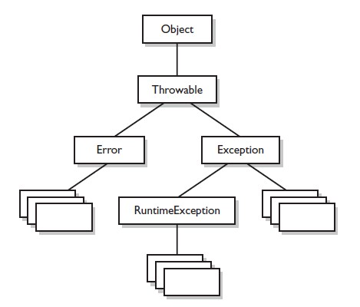
Exception Hierarchy

Slide 75
try-catch-finally
try
{
// statements that can result is exception
}
catch(<ExceptionType> <var> )
{
// similar to a method and declares a parameter of the exception //type that it wants to handle.
//handles exceptions that occurs in its try blocks.
}
finally
{
// some cleanup code
}

Slide 76
The order must be same.
A try can have zero or more catch and zero or more finally.
A try without catch/finally and a catch/finally without try is an error.
The block notation is mandatory.
A catch block for super-type exception must not shadow a catch block for subtype exception.
The finally block is always executed so it can contain any clean-up code.
An exception in finally block over rules any previously unhandled exception.

Slide 77
Locate appropriate
Catch block
try
catch
finally
To the caller
Normal execution

Slide 78
Trace a Program Execution
animation
Suppose no exceptions in the statements
try {
statements;
}
catch(TheException ex) {
handling ex;
}
finally {
finalStatements;
}
Next statement;

Slide 79
Trace a Program Execution
animation
The final block is always executed
try {
statements;
}
catch(TheException ex) {
handling ex;
}
finally {
finalStatements;
}
Next statement;

Slide 80
Trace a Program Execution
animation
Next statement in the method is executed
try {
statements;
}
catch(TheException ex) {
handling ex;
}
finally {
finalStatements;
}
Next statement;

Slide 81
Trace a Program Execution
animation
try {
statement1;
statement2;
statement3;
}
catch(Exception1 ex) {
handling ex;
}
finally {
finalStatements;
}
Next statement;
Suppose an exception of type Exception1 is thrown in statement2

Slide 82
Trace a Program Execution
animation
try {
statement1;
statement2;
statement3;
}
catch(Exception1 ex) {
handling ex;
}
finally {
finalStatements;
}
Next statement;
The exception is handled.

Slide 83
Trace a Program Execution
animation
try {
statement1;
statement2;
statement3;
}
catch(Exception1 ex) {
handling ex;
}
finally {
finalStatements;
}
Next statement;
The final block is always executed.

Slide 84
Trace a Program Execution
animation
try {
statement1;
statement2;
statement3;
}
catch(Exception1 ex) {
handling ex;
}
finally {
finalStatements;
}
Next statement;
The next statement in the method is now executed.

Slide 85
Trace a Program Execution
animation
try {
statement1;
statement2;
statement3;
}
catch(Exception1 ex) {
handling ex;
}
catch(Exception2 ex) {
handling ex;
throw ex;
}
finally {
finalStatements;
}
Next statement;
statement2 throws an exception of type Exception2.

Slide 86
Trace a Program Execution
animation
try {
statement1;
statement2;
statement3;
}
catch(Exception1 ex) {
handling ex;
}
catch(Exception2 ex) {
handling ex;
throw ex;
}
finally {
finalStatements;
}
Next statement;
Handling exception

Slide 87
Trace a Program Execution
animation
try {
statement1;
statement2;
statement3;
}
catch(Exception1 ex) {
handling ex;
}
catch(Exception2 ex) {
handling ex;
throw ex;
}
finally {
finalStatements;
}
Next statement;
Execute the final block

Slide 88
Trace a Program Execution
animation
try {
statement1;
statement2;
statement3;
}
catch(Exception1 ex) {
handling ex;
}
catch(Exception2 ex) {
handling ex;
throw ex;
}
finally {
finalStatements;
}
Next statement;
Rethrow the exception and control is transferred to the caller

Slide 89
Exception
Unchecked Exception
Checked Exception

Slide 90
Unchecked Exceptions
Object of RuntimeException , Error and their subclasses are known as unchecked exceptions.
The method that can have these exceptions is not obliged to handle them.
These are either programming errors or irrecoverable.
A NullPointerException is thrown if you access an object through a reference variable before an object is assigned to it.
An IndexOutOfBoundsException is thrown if you access an element in an array outside the bounds of the array.
These are the logic errors that should be corrected in the program. Unchecked exceptions can occur anywhere in the program. To avoid cumbersome overuse of try-catch blocks, Java does not mandate you to write code to catch unchecked exceptions.

Slide 91
Checked Exceptions
All other exceptions are known as checked exceptions, meaning that the compiler forces the programmer to check and deal with the exceptions.
If these can occurs in a method . The method must have one of the following actions to deal with them:
Try construct
Throws clause
By declaring a exception in its throws clause a method indicate that the specifies or its sub class can occur in the method and it is handled by its caller.
Syntax:
--<methodName>(---) throws< ExceptionType1> < ExceptionType1> {===}

Slide 92
Creating Custom Exception Classes
We can create our own exception type by inheriting Exception
Use the exception classes in the API whenever possible.
Create custom exception classes if the predefined classes are not sufficient.
Example:
class MyException extends Exception
{
MyException(String reason)
{
super(reason);
}
}

Slide 93
Throwing Exceptions
When the program detects an error, the program can create an instance of an appropriate exception type and throw it. This is known as throwing an exception. Here is an example,
throw new MyException();
Or
MyException ex = new MyException(); throw ex;
public float calSalary(int basic,int DA)
throws MyException
{
if (basic <= 0)
throw new MyException(“Basic is not valid");
// some code
}

Slide 94
When to Use Exceptions
When should you use the try-catch block in the code? You should use it to deal with unexpected error conditions. Do not use it to deal with simple, expected situations. For example, the following code
try {
System.out.println(refVar.toString());
}
catch (NullPointerException ex) {
System.out.println("refVar is null");
}

Slide 95
When to Use Exceptions
is better to be replaced by
if (refVar != null)
System.out.println(refVar.toString());
else
System.out.println("refVar is null");

Slide 96
Cautions When Using Exceptions
Exception handling separates error-handling code from normal programming tasks, thus making programs easier to read and to modify. Be aware, however, that exception handling usually requires more time and resources because it requires instantiating a new exception object, rolling back the call stack, and propagating the errors to the calling methods.

Slide 97
When to Throw Exceptions
An exception occurs in a method. If we want the exception to be processed by its caller, we should create an exception object and throw it. If we can handle the exception in the method where it occurs, there is no need to throw it.

Slide 98
Object Oriented Programming

Slide 99
Inheritance
It is a way of code reusability.
Central to Java and other object-oriented (OO) languages is the concept of inheritance, which allows code defined in one class to be reused in other classes.
In Java, we can define a general (more abstract) super-class, and then extend it with more specific subclasses. The super-class knows nothing of the classes that inherit from
it, but all of the subclasses that inherit from the super-class must explicitly declare the inheritance relationship.
A subclass that inherits from a super-class is automatically
given accessible instance variables and methods defined by the super-class, but is also free to override super-class methods to define more specific behavior.

Slide 100
A subtype inherits members from its super-type.
It can declares new members and it required can change inherited behavior.
Java supports single inheritance using classes.
The subclass uses extends keyword to specifies its super class
If a class declaration does not contains extends keyword . It implicitly inherits java.lang.Object

Slide 101
Object
Person
Animal
Employee
Cat
Hippo
Dog
Manager

Slide 102
Method Overriding
A subclass can redefine a method inherited from its super-class . The rules:
The name and parameter list must be same.
The return type must be same or it can be a subtype.
The new method definition cannot narrow the accessibility of the method , but it can widen it.
The overriding method declare a subset of exception classes(including sub classes) that are declared in throws clause of overridden method.
Static method cannot override an instance method and the reverse.
A super-type variable can contain the reference of subtype object.
The call of the static method is resolved by the type of the object reference value.
The call of instance method is resolved by the type of object . Here the actual method lookup procedure is:
If the object type contains a method i.e. resolved and the resolved method is accessible from the type then it is invoked
Otherwise the same procedure is performed in its super-classes.
At last if method is not found we will get AbstractMethodError .

Slide 103
Field Hiding A subtype can re-declare a field inherited from its super-class. It is the type of reference value/variable that determines the field access.
Class A
{
int i ;
void f1(){=}
}
class B extends A
{
float i;
void f1(){=}
void f2(){=}
}
class C extends B
{
String i;
void f1(){=}
void f3(char i)
{
System.out.println(i);
System.out.println(this.i);
System.out.println(super.i);
f1();
super.f1();
}
}

Slide 104
Object Reference ‘this’
When an instance method is called the reference of the object is implicitly passed in the method.
With the method body the reference is accessible using ‘this’.
In the method body when a variable is accessed it is first searched locally , if not found , the reference ‘this ’ is apply.
When a method is call with class name/reference , the
reference ‘this’ is applied.
Static methods does not have ‘this’ . Here the class name is applied.

Slide 105
Object Reference ‘super’
In an instance method of the class the super contains the reference of its immediate super class that is associated with this reference of the sub-class.
The super cannot be use as ordinary reference . It can only be use to access members.

Slide 106
Constructor chaining using “this()”
The call can be use in a constructor to invoke another constructor of the same class.
The call must be within the constructor and the first statement.
class A
{
int i , j;
A()
{
//i=10;
// j=20;
this(10);
}
A(int i)
{
//this.i;
//j=20;
this(i,20);
}
A(int c,int d)
{
i=c;
j=d;
}
}
A v1= new A();
A v1= new A(3);
A v1= new A(2,3);

Slide 107
Constructor chaining using “super()”
The call can be use in the constructor to invoke the constructor of its immediate super-class.
This facilitates the initialization of the super class object , when sub-class is instanciated
The call must be within the constructor and the first statement.
If there is no this()/super() call in a constructor , the compiler implicitly insert a super() in the constructor.

Slide 108
class B extends A
{ int p;
B()
{
p=50
}
B(int q)
{
super(q*2);
}
}
Class A
{
int r;
void f1()
{=}
A(int q)
{
r=q;
}
}

Slide 109
Interface
Interface can be used to declare a new define type.
They provide multiple inheritance.
The syntax is:
<access modifier> interface <name> <extends>
{
//body
}
The interface body contains:
Methods:-
Are implicitly public , abstract
Fields:-
Are implicitly public , static , final
Nested Type:-
The interface are implicitly abstract

Slide 110
An interface can inherits one or more interfaces using extends keyword.
If an interface declaration is not using extends it implicitly provides the abstract declaration of all the methods of Object class.
A class can implement more than one interface using implements keyword.
Interface does not contained initializer blocks.
Here the class has to define(override) the methods from the interfaces otherwise the class becomes abstract.
It is guaranteed to make subclass of interface so , interface are always super-types.

Slide 111
Reference Assignment
<destType> = <srcType>
If a srcType is class type , then the type of destType can be:
A super-class
An implimented interface
If a srcType is interface type , then the type of destType can be:
Object
A super interface
If a srcType is primitive array then the type of destType can be:
Object
Serializable/Clonable interface
If a srcType is reference type array then the type of destType can be:
Object
Serializable/Clonable interface
An array type where the element type of the srcType is assignable to the element type of the destType.

Slide 112
Nested Class
The Java programming language allows you to define a class within another class. Such a class is called a nested class .
class OuterClass
{
...
class NestedClass
{ ... }
}
Nested classes are divided into two categories:
static and non-static.
(1) Nested classes that are declared static are simply called static nested classes.
(2)Non-static nested classes are called inner classes.
An interface declared in a class is implicitly static.
An class declared in an interface is implicitly public, static.

Slide 113
Static Nested Classes
A nested class that is declared static is called a static nested class.
Memory to the objects of any static nested classes are allocated independently of any particular outer class object.
A static nested class use the instance variables or methods defined in its enclosing class only through an object reference.
A static nested class interacts with the instance members of its outer class or any other class just like a top-level class.

Slide 114
Inner Class
An inner class is associated with an instance of its enclosing class and has direct access to that object's methods and fields.
Also, because an inner class is associated with an instance, it cannot define any static members itself.
Objects that are instances of an inner class exist within an instance of the outer class.
Except the inner class, there are two types of supplementary inner classes :
The inner class which is declared inside the body of a method is known as the local inner classes.
The class declared inside the body of a method without naming it is known as anonymous inner classes.

Slide 115
Example
public class OuterClass{
static class StaticNestedClass {
public void checkSN(){
System.out.println("I m in Static nested class " );
}}
class InnerClass{
public void checkI(){
System.out.println("I m in Inner class " );
}}
public static void main(String args[])
{// FOR INNER CLASS
//InnerClass in =new InnerClass();//wrong
OuterClass out =new OuterClass(); // first make outer class object
InnerClass in=out.new InnerClass(); // then make inner class object
in.checkI();
// FOR STATICNESTED CLASS
OuterClass.StaticNestedClass sn= new OuterClass.StaticNestedClass();
sn.checkSN();
} }

Slide 116
Local class
A local class is declared locally within a block of Java code, rather than as a member of a class.
Typically, a local class is defined within a method, but it can also be defined within a static initializer or instance initializer of a class.
public class MyClass {
public void myMethod() { // Anonymous inner class Runnable r = new Runnable() { public void run() {} }; // Local inner class class LocalClass implements Runnable { public void run() {} } } }

Slide 117
Anonymous classes
An anonymous class is a local class without a name. An anonymous class is defined and instantiated in a single succinct expression using the new operator.
Anonymous class definition is an expression, which means that it can be included as part of a larger expression, such as a method call.
When a local class is used only once, consider using anonymous class syntax, which places the definition and use of the class in exactly the same place.
The anonymous inner classes is very useful in some situation. For example consider a situation where we need to create the instance of an object without creating subclass of a class and also performing additional tasks such as method overloading.
Example:
button.addActionListener(new ActionListener() { public void actionPerfored(ActionEvent e) { // do something. } });

Slide 118
Garbage Collector
The garbage collector is the part of the JVM.
The JVM invokes it when there is lack of memory(heap) for new objects.
The garbage collector identifies the objects that are no longer accessible and reclaims the area occupied by them.
Garbage collection relieves java programmer from memory management which is essential part of C++ programming and gives more time to focus on business logic.
Garbage Collection in Java is carried by a daemon thread called Garbage Collector.
Before removing an object from memory Garbage collection thread invokes finalize () method of that object and gives an opportunity to perform any sort of cleanup required.
We as Java programmer can not force Garbage collection in Java; it will only trigger if JVM thinks it needs a garbage collection based on Java heap size.
There are methods like System.gc () and Runtime.gc () which is used to send request of Garbage collection to JVM but it’s not guaranteed that garbage collection will happen.
If there is no memory space for creating new object in Heap Java Virtual Machine throws OutOfMemoryError or java.lang.OutOfMemoryError heap space

Slide 119
When an Object becomes Eligible for Garbage Collection
An Object becomes eligible for Garbage collection or GC if its not reachable from any live threads or any static references.
An object becomes eligible for garbage collection if its all references are null.
Cyclic dependencies are not counted as reference so if Object A has reference of object B and object B has reference of Object A and they don't have any other live reference then both Objects A and B will be eligible for Garbage collection.
Generally an object becomes eligible for garbage collection in Java on following cases:
1) All references of that object explicitly set to null e.g. object = null 2) Object is created inside a block and reference goes out scope once control exit that block. 3) Parent object set to null, if an object holds reference of another object and when we set container object's reference null, child or contained object automatically becomes eligible for garbage collection.
4) if there are two references of that object pointing different objects of same type and we assign one’s reference value to another , then second object is becomes eligible for garbage collection.

Slide 120
Object Finalization
Objects can have resources associated with them.
It is their responsibility to free the resources.
The finalize() , is declared in Object class and is call by garbage collector once , just before destroying the object.
An object can take any last action using this method just before its area is reclaimed by the garbage collector
The finalize () method can also be used to make an object accessible again.
The finalizer in the sub-class should call the finalizer of its super-class as its last action , because unlike constructor finalizer are not chained.

Slide 121
The Object finalize method performs no actions but it may be overridden by any class
Normally it should be overridden to clean-up non-Java resources i.e .closing a file
if overridding finalize() it is good programming practice to use a try-catch-finally statement and to always call super.finalize().
This is a saftey measure to ensure you do not inadvertently miss closing a resource used by the objects calling class
protected void finalize() throws Throwable
{ try
{ close(); // close open files }
finally { super.finalize(); }
}
Any exception thrown by finalize() during garbage collection halts the finalization but is otherwise ignored
finalize() is never run more than once on any object.

Slide 122
ultra-super-megaclass Object
The Object class sits at the top of the class hierarchy tree in the Java development environment.
Every class in the Java system is a descendent (direct or indirect) of the Object class.
The Object class defines the basic state and behavior that all objects must have, such as the ability to compare oneself to another object, to convert to a string, to wait on a condition variable, to notify other objects that a condition variable has changed, and to return the object's class.
(1)boolean equals(Object):-
Use the equals to compare two objects for equality. This method returns true if the objects are equal, false otherwise. Note that equality does not mean that the objects are the same object.
Integer one = new Integer(1);
anotherOne = new Integer(1);
if (one.equals(anotherOne))
System.out.println("objects are equal");

Slide 123
(2)final Class getClass():-
The getClass method is a final method (cannot be overridden) that returns a runtime representation of the class of this object. This method returns a Class object.
void PrintClassName(Object obj) { System.out.println("The Object's class is " + obj.get
Class().getName()); }
(3)String toString():-
Object's toString method returns a String representation of the object. We can use toString to display an object.
For example, we could display a String representation of the current Thread like this: System.out.println(Thread.currentThread().toString());
The String representation for an object is entirely dependent on the object. The String representation of an Integer object is the integer value displayed as text.
The String representation of a Thread object contains various attributes about the thread, such as its name and priority .
Thread[main,5,main]

Slide 124
(4) int hashCode():-
This method returns unique id for an object. It is used in collections.
(5)Protected Object clone() throws CloneNotSupporyedException:-
clone() is a method in the Java programming language for object duplication.
In Java, objects are manipulated through reference variables, and there is no operator for copying an object—the assignment operator duplicates the reference, not the object.
The clone() method provides this missing functionality.
The object to be clone must implement Clonable interface other wise will get exception.

Slide 125
Wrapper classes
Corresponding to every primitive type , there is a class that represents the primitive values as an object.
These are:
Byte , Short , Character , Integer , Float , Long , Double , Boolean , Void.
The Void is non instanceable and represents the return type void.
These classes(except charactor) provide two constructor to create object.
Since java-5,the primitive values are implicitly converted to the wrapper types and the reverse .This is called autoboxing and unboxing.
The numeric wrapper classes provide constant:
MIN_VALUE and MAX_VALUE to represent the corresponding primitive type.
The numeric wrapper classes provide static method parseX() to convert the string values in corresponding primitive type.
These method can throw-NumberFormatException.

Slide 126
Integer i1= new Integer(10);
Integer i2= new Integer("10");
Integer i3=10; //autoboxing
int k=i3; // unboxing
Use of parseX()
int j= Integer.parseInt("40");
double d= Double.parseDouble("2.3");
int risky=Integer.parseInt("Abs");//NumberFormatException
Use of constant
Integer.MIN_VALUE;
Integer.MAX_VALUE;

Slide 127
String Class
An objects of String class represents sequence of characters.
The object is non-changeable/immutable.
The String literals are represent using object of String class.
Two literal with same character sequence are represented by same object.
A simple String can be created using a string literal enclosed inside double quotes as shown;
String str1 = “My name is bob”;
Since a string literal is a reference, it can be manipulated like any other String reference. The reference value of a string literal can be assigned to another String reference.

Slide 128
If two or more Strings have the same set of characters in the same sequence then they share the same reference in memory. Below illustrates this phenomenon.
String str1 = “My name is bob”; String str2 = “My name is bob”;
String str3 = “My name ”+ “is bob”;//Compiletimeexpression String name = “bob”; String str4 = “My name is” + name; String str5 = new String(“My name is bob”);
In the above code all the String references str1, str2 and str3 denote the same String object, initialized with the character string: “My name is bob”. But the Strings str4 and str5 denote new String objects.

Slide 129
Difference between String , StringBuffer and StringBuilder
Well, the most important difference between String and StringBuffer/StringBuilder in java is that String object is immutable whereas StringBuffer/StringBuilder objects are mutable.
By immutable, we mean that the value stored in the String object cannot be changed.
Then the next question that comes to our mind is “If String is immutable then how am I able to change the contents of the object whenever I wish to?” . Well, to be precise it’s not the same String object that reflects the changes you do. Internally a new String object is created to do the changes.
So suppose we declare a String object:
String s = “abc”;
String s2=s;
Next, we want to append “Guest” to the same String. What do you do?
s = s + ” def”;
When we print the contents of myString the output will be
“Hello Guest”.

Slide 130
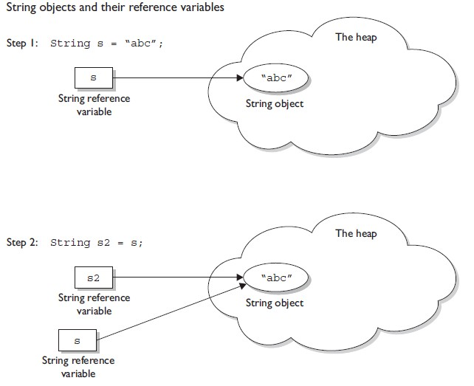
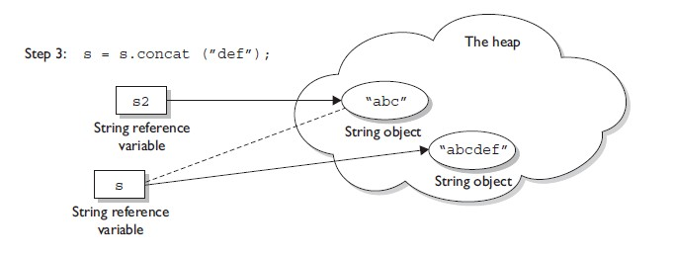

Slide 131
Now isn’t that a performance issue?
Yes, it definitely is.
Then how do we make our string operations efficient?
By using StringBuffer or StringBuilder.
How would that help?
Well, since StringBuffer/StringBuilder objects are mutable, we can make changes to the value stored in the object. What this effectively means is that string operations such as append would be more efficient if performed using StringBuffer/StringBuilder objects than String objects.
Finally, whats the difference between StringBuffer and StringBuilder?
StringBuffer and StringBuilder have the same methods with one difference and that’s of synchronization.
StringBuffer is synchronized(thread safe) whereas StringBuilder is not synchronized(it isn’t thread safe).
So, if we aren’t going to use threading then use the StringBuilder class as it’ll be more efficient than StringBuffer due to the absence of synchronization.

Slide 132
The three principles of OOP
Encapsulation
Objects hide their functions (methods) and data (instance variables)
Inheritance
Each subclass inherits all variables of its superclass
Polymorphism
Interface same despite different data types
car
Super class
manual
auto-
matic
Subclasses
draw()
draw()

Slide 133
Using objects
Here, code in one class creates an instance of another class and does something with it …
Fruit plum=new Fruit();
int cals;
cals = plum.total_calories();
Dot operator allows you to access (public) data/methods inside Fruit class

Slide 134
Stream Manipulation

Slide 135
Streams and I/O
Stream is a general mechanism of I/O in java.
Stream provides sequential access of data.
An input stream can be used by an application to read data. An output stream to write data.
Streams are categorized as:
Byte Stream :Binary
Character Stream:Text
A file , network connection , arrays can act as stream.
Whenever we have to make program of I/O then we use java.io package

Slide 136
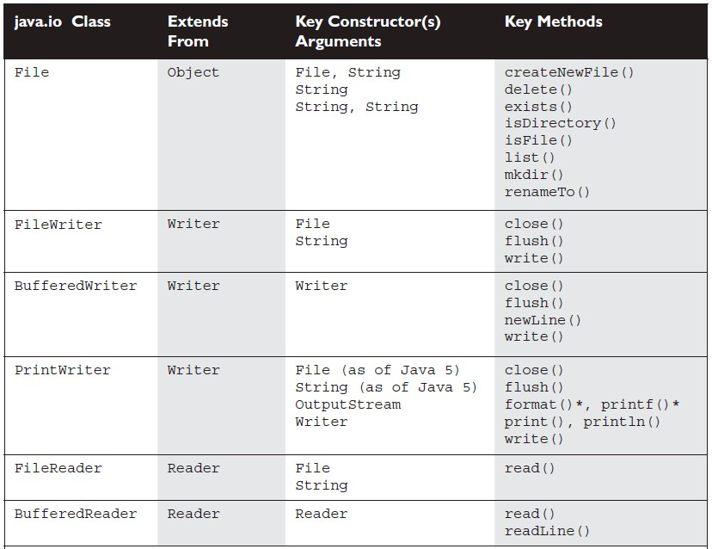

Slide 137
Basic classes for file IO
FileInputStream , for reading from a file
FileOutputStream , for writing to a file
Example:
Open a file "myfile.txt" for reading FileInputStream fis= new FileInputStream("myfile.txt");
Open a file "outfile.txt" for writing
FileOutputStream fos = new FileOutputStream("myfile.txt");

Slide 138
Display File Contents
import java.io.*;
public class FileToOut1 {
public static void main(String args[]) {
try {
FileInputStream infile = new FileInputStream("testfile.txt");
byte buffer[] = new byte[50];
int nBytesRead;
do {
nBytesRead = infile.read(buffer);
System.out.write(buffer, 0, nBytesRead);
} while (nBytesRead == buffer.length);
}
catch (FileNotFoundException e) {
System.err.println("File not found");
}
catch (IOException e) { System.err.println("Read failed"); }
}
}

Slide 139
Object serialization
Primary purpose of java serialization is to write an object into a stream, so that it can be transported through a network and that object can be rebuilt again.
Write objects to a file, instead of writing primitive types.
During serialization the following information is send to the stream:
The values of all non-transient and non- static fields
The class information needed to reconstruct the object
(class name , package etc.).
During serialization aggregate state is implicitly serialized.
The object to be serialized must implements Serializable interface
Use the ObjectInputStream , ObjectOutputStream classes, the same way that filters are used.

Slide 140
Write an object to a file
import java.io.*;
import java.util.*;
public class WriteDate {
public WriteDate () {
Date d = new Date();
try {
FileOutputStream f = new FileOutputStream("date.ser");
ObjectOutputStream s = new ObjectOutputStream (f);
s.writeObject (d);
s.close ();
}
catch (IOException e) { e.printStackTrace(); }
public static void main (String args[]) {
new WriteDate ();
}
}

Slide 141
Read an object from a file
import java.util.*;
public class ReadDate {
public ReadDate () {
Date d = null;
ObjectInputStream s = null;
try { FileInputStream f = new FileInputStream ("date.ser");
s = new ObjectInputStream (f);
} catch (IOException e) { e.printStackTrace(); }
try { d = (Date)s.readObject (); }
catch (ClassNotFoundException e) { e.printStackTrace(); }
catch (InvalidClassException e) { e.printStackTrace(); }
catch (StreamCorruptedException e) { e.printStackTrace(); }
catch (OptionalDataException e) { e.printStackTrace(); }
catch (IOException e) { e.printStackTrace(); }
System.out.println ("Date serialized at: "+ d);
}
public static void main (String args[]) { new ReadDate (); }
}

Slide 142
Java Collections

Slide 143
Java Collections Framework
The Java language API provides many of the data structures from this class for you.
It defines a “collection” as “an object that represents a group of objects”.
It defines a collections framework as “a unified architecture for representing and manipulating collections, allowing them to be manipulated independent of the details of their representation.”
The core collection interfaces encapsulate different types of collections. They represent the abstract data types that are part of the collections framework. They are interfaces so they do not provide an implementation!
Three meanings for "collection":
1. collection (lowercase c): Represents the data structure in which objects are stored
2. Collection(java.util.Collection):It is an interface from which Set and List extend
3. Collections(java.util.Collections): A class that holds static collection utility methods

Slide 144
ArrayList: Fast iteration and fast random access.
Vector: It's like a slower ArrayList, but it has synchronized methods.
LinkedList: Good for adding elements to the ends, i.e., stacks and queues.
HashSet: Fast access, assures no duplicates, provides no ordering.
LinkedHashSet: No duplicates; iterates by insertion order.
TreeSet: No duplicates; iterates in sorted order.
HashMap: Fastest updates (key/values); allows one null key, many null values.
Hashtable: Like a slower HashMap (as with Vector, due to its synchronized methods). No null values or null keys allowed.
LinkedHashMap: Faster iterations; iterates by insertion order or last accessed; allows one null key, many null values.
TreeMap: A sorted map.
PriorityQueue: A to-do list ordered by the elements' priority.

Slide 145
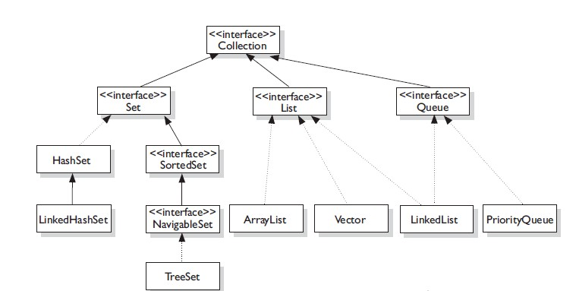
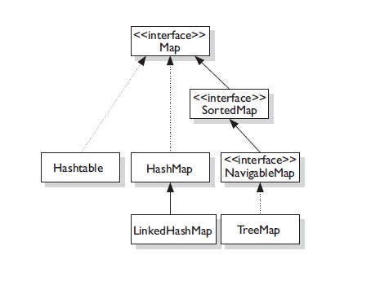
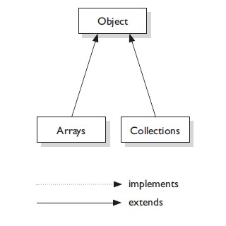

Slide 146
public interface Collection<E> extends Iterable<E>
Collection — the root of the collection hierarchy. A collection represents a group of objects known as its elements. The Collection interface is the least common denominator that all collections implement and is used to pass collections around and to manipulate them when maximum generality is desired. Some types of collections allow duplicate elements, and others do not. Some are ordered and others are unordered. The Java platform doesn't provide any direct implementations of this interface but provides implementations of more specific subinterfaces, such as Set and List.

Slide 147
public interface Collection<E> extends Iterable<E>
public interface Collection<E> extends Iterable<E> {
// Basic operations
int size();
boolean isEmpty();
boolean contains(Object element);
boolean add(E element); //optional
boolean remove(Object element); //optional
Iterator<E> iterator();
// Bulk operations
boolean containsAll(Collection<?> c);
boolean addAll(Collection<? extends E> c); //optional
boolean removeAll(Collection<?> c); //optional
boolean retainAll(Collection<?> c); //optional
void clear(); //optional
// Array operations
Object[] toArray();
<T> T[] toArray(T[] a);
}

Slide 148
A note on iterators
An Iterator is an object that enables you to traverse through a collection and to remove elements from the collection selectively, if desired. You get an Iterator for a collection by calling its iterator() method. The following is the Iterator interface.
public interface Iterator<E> {
boolean hasNext();
E next();
void remove(); //optional
}

Slide 149
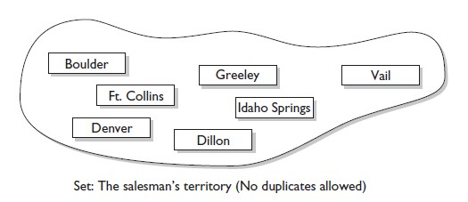
public interface Set<E> extends Collection<E>
Set — A Set cares about uniqueness—it doesn't allow duplicates elements.
The three Set implementations are:
HashSet
LinkedHashSet
TreeSet

Slide 150
public interface Set<E>extends Collection<E>
public interface Set<E> extends Collection<E> {
// Basic operations
int size();
boolean isEmpty();
boolean contains(Object element);
boolean add(E element); //optional
boolean remove(Object element); //optional
Iterator<E> iterator();
// Bulk operations
boolean containsAll(Collection<?> c);
boolean addAll(Collection<? extends E> c); //optional
boolean removeAll(Collection<?> c); //optional
boolean retainAll(Collection<?> c); //optional
void clear(); //optional
// Array Operations
Object[] toArray();
<T> T[] toArray(T[] a);
}

Slide 151
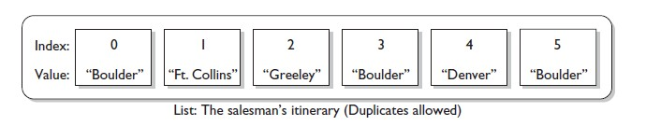
public interface List<E>extends Collection<E>
List — an ordered collection (sometimes called a sequence).
Lists can contain duplicate elements. The user of a List generally has precise control over where in the list each element is inserted and can access elements by their integer index (position).
A List cares about the index. The one thing that List has that non-lists don't have is a set of methods related to the index. Those key methods include things like get(int index), indexOf(Object o), add(int index, Object obj), and so on.
All three List implementations are ordered by index position:-
(1) ArrayList
(2)Vector
(3) LinkedList

Slide 152
public interface List<E>extends Collection<E>
public interface List<E> extends Collection<E> {
// Positional access
E get(int index);
E set(int index, E element); //optional
boolean add(E element); //optional
void add(int index, E element); //optional
E remove(int index); //optional
boolean addAll(int index,
Collection<? extends E> c); //optional
// Search
int indexOf(Object o);
int lastIndexOf(Object o);
// Iteration
ListIterator<E> listIterator();
ListIterator<E> listIterator(int index);
// Range-view
List<E> subList(int from, int to);
}

Slide 153

A note on ListIterators
The three methods that ListIterator inherits from Iterator (hasNext, next, and remove) do exactly the same thing in both interfaces. The hasPrevious and the previous operations are exact analogues of hasNext and next. The former operations refer to the element before the (implicit) cursor, whereas the latter refer to the element after the cursor. The previous operation moves the cursor backward, whereas next moves it forward.
The nextIndex method returns the index of the element that would be returned by a subsequent call to next, and previousIndex returns the index of the element that would be returned by a subsequent call to previous
The set method overwrites the last element returned by next or previous with the specified element.
The add method inserts a new element into the list immediately before the current cursor position.
public interface ListIterator<E> extends Iterator<E> {
boolean hasNext();
E next();
boolean hasPrevious();
E previous();
int nextIndex();
int previousIndex();
void remove(); //optional
void set(E e); //optional
void add(E e); //optional
}

Slide 154
public interface Queue<E>extends Collection<E>
Queue — a collection used to hold multiple elements prior to processing. Besides basic Collection operations, a Queue provides additional insertion, extraction, and inspection operations.
Although other orders are possible, queues are typically thought of as FIFO (first-in,first-out).
PriorityQueue:-
This class is new with Java 5.
Since the LinkedList class has been enhanced to implement the Queue interface, basic queues can be handled with a LinkedList.
The purpose of a PriorityQueue is to create a “priority-in, priority-out” queue as opposed to a typical FIFO queue.

Slide 155
public interface Queue<E>extends Collection<E>
public interface Queue<E> extends Collection<E> {
E element(); //throws
E peek(); //null
boolean offer(E e); //add - bool
E remove(); //throws
E poll(); //null
}

Slide 156
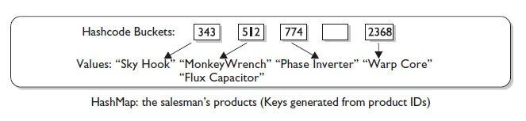
public interface Map<K,V>
Map — an object that maps keys to values. A Map cannot contain duplicate keys; each key can map to at most one value. If you've used Hashtable, you're already familiar with the basics of Map.
The three Set implementations are:
HashMap
Hashtable
LinkedHashMap
TreeMap

Slide 157
public interface Map<K,V>
public interface Map<K,V> {
// Basic operations
V put(K key, V value);
V get(Object key);
V remove(Object key);
boolean containsKey(Object key);
boolean containsValue(Object value);
int size();
boolean isEmpty();
// Bulk operations
void putAll(Map<? extends K, ? extends V> m);
void clear();
// Collection Views
public Set<K> keySet();
public Collection<V> values();
public Set<Map.Entry<K,V>> entrySet();
// Interface for entrySet elements
public interface Entry {
K getKey();
V getValue();
V setValue(V value);
}
}

Slide 158
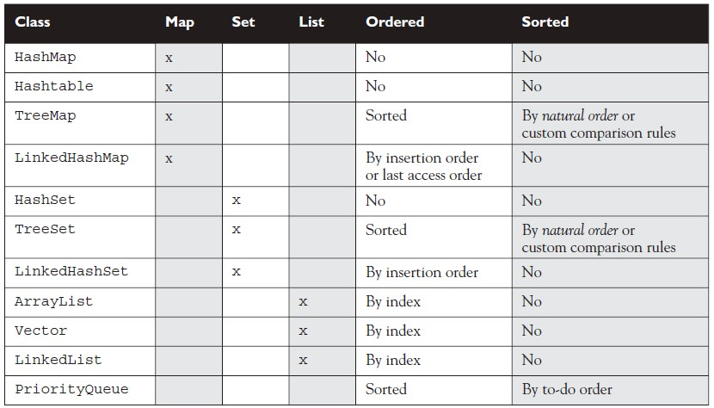

Slide 159
Java Threads

Slide 160
Multitasking and Multithreading
Multitasking:
refers to a computer's ability to perform multiple jobs concurrently
more than one program are running concurrently, e.g., UNIX
Multithreading:
A thread is a single sequence of execution within a program
refers to multiple threads of control within a single program
each program can run multiple threads of control within it, e.g., Web Browser

Slide 161
Concurrency vs. Parallelism
CPU
CPU1
CPU2

Slide 162
Threads and Processes
CPU
Process 1
Process 2
Process 3
Process 4
main
run
GC

Slide 163
What are Threads Good For?
To maintain responsiveness of an application during a long running task
To enable cancellation of separable tasks
Some problems are intrinsically parallel
To monitor status of some resource (e.g., DB)
Some APIs and systems demand it (e.g., Swing)

Slide 164
Application Thread
When we execute an application:
The JVM creates a Thread object whose task is defined by the main() method
The JVM starts the thread
The thread executes the statements of the program one by one
After executing all the statements, the method returns and the thread dies

Slide 165
Multiple Threads in an Application
Each thread has its private run-time stack
If two threads execute the same method, each will have its own copy of the local variables the methods uses
However, all threads see the same dynamic memory, i.e., heap (are there variables on the heap?)
Two different threads can act on the same object and same static fields concurrently

Slide 166
Creating Threads
There are two ways to create our own Thread object
(1)Subclassing the Thread class and instantiating a new object of that class
(2)Implementing the Runnable interface
In both cases the run() method should be implemented
Thread objects can also be created by calling the Thread constructor that takes a Runnable argument. The Runnable object is said to be the target of the thread.
We can call start() on a Thread object only once. If start() is called more than once on a Thread object, it will throw a RuntimeException.
It is legal to create many Thread objects using the same Runnable object as the target.
When a Thread object is created, it does not become a thread of execution until its start() method is invoked. When a Thread object exists but hasn't been started, it is in the new state and is not considered alive.

Slide 167
Extending Thread
class MyThread extends Thread
{
public void run()
{
System.out.println("Important job running in MyThread");
}
}

Slide 168
Thread Methods
void start()
Creates a new thread and makes it runnable
This method can be called only once
void run()
The new thread begins its life inside this method
void stop() (deprecated)
The thread is being terminated

Slide 169
Thread Methods
void yield()
Causes the currently executing thread object to temporarily pause and allow other threads to execute
Allow only threads of the same priority to run
void sleep(int m) or sleep(int m, int n)
The thread sleeps for m milliseconds, plus n nanoseconds

Slide 170
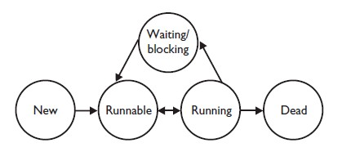
Transitioning Between Thread States
Once a new thread is started, it will always enter the runnable state.
The thread scheduler can move a thread back and forth between the runnable state and the running state.
For a typical single-processor machine, only one thread can be running at a time, although many threads may be in the runnable state.
There is no guarantee that the order in which threads were started determines the order in which they'll run.

Slide 171
There's no guarantee that threads will take turns in any fair way. It's up to the thread scheduler, as determined by the particular virtual machine implementation. If you want a guarantee that your threads will take turns regardless of the underlying JVM, you can use the sleep() method. This prevents one thread from hogging the running process while another thread starves. (In most cases, though, yield() works well enough to encourage your threads to play together nicely.)
A running thread may enter a blocked/waiting state by a wait(), sleep(),or join() call.
A running thread may enter a blocked/waiting state because it can't acquire the lock for a synchronized block of code.
When the sleep or wait is over, or an object's lock becomes available, the thread can only re-enter the runnable state. It will go directly from waiting to running (well, for all practical purposes anyway).
A dead thread cannot be started again.

Slide 172
Implementing Runnable
class MyRunnable implements Runnable
{
public void run()
{
System.out.println("Important job running in MyRunnable");
}
}

Slide 173
A Runnable Object
When running the Runnable object, a Thread object is created from the Runnable object
The Thread object’s run() method calls the Runnable object’s run() method
Allows threads to run inside any object, regardless of inheritance

Slide 174
Starting the Threads
public class TestThreads
{
public static void main (String [] args)
{
MyRunnable r = new MyRunnable();
Thread foo = new Thread(r);
Thread bar = new Thread(r);
Thread bat = new Thread(r);
}
}

Slide 175
Scheduling Threads
start()
Ready queue
Newly created
threads
Currently executed
thread
I/O operation completes
Waiting for I/O operation to be completed
Waiting to be notified
Sleeping
Waiting to enter a synchronized section

Slide 176
Thread State Diagram
Alive
Running
new ThreadExample();
while (…) { … }
New Thread
Runnable
Dead Thread
thread.start();
run() method returns
Blocked
Object.wait()
Thread.sleep()
blocking IO call
waiting on a monitor

Slide 177
Scheduling
Thread scheduling is the mechanism used to determine how runnable threads are allocated CPU time.
A thread-scheduling mechanism is either preemptive or nonpreemptive.
Preemptive scheduling – the thread scheduler preempts (pauses) a running thread to allow different threads to execute
Nonpreemptive scheduling – the scheduler never interrupts a running thread.
The nonpreemptive scheduler relies on the running thread to yield control of the CPU so that other threads may execute.

Slide 178
Starvation
A nonpreemptive scheduler may cause starvation (runnable threads, ready to be executed, wait to be executed in the CPU a very long time, maybe even forever)
Sometimes, starvation is also called a livelock

Slide 179
Time-Sliced Scheduling
Time-sliced scheduling
the scheduler allocates a period of time that each thread can use the CPU
when that amount of time has elapsed, the scheduler preempts the thread and switches to a different thread
Nontime-sliced scheduler
the scheduler does not use elapsed time to determine when to preempt a thread
it uses other criteria such as priority or I/O status

Slide 180
Java Scheduling
Execution of multiple threads in some order on a single CPU system is called scheduling .
Java uses fixed-priority scheduling algorithms to decide which thread to execute
The thread with the highest priority runs first
if another thread with a higher priority is started, Java makes the lower priority thread wait
If more than one thread exists with the same priority, Java quickly switches between them in round-robin fashion BUT only if the operating system uses time-slicing.
It is possible to assign a thread priority.
Top priority is 10, lowest priority is 1 , Normal priority i.e. priority by default is 5.
Thread.MIN_PRIORITY - minimum thread priority
Thread.MAX_PRIORITY - maximum thread priority
Thread.NORM_PRIORITY - maximum thread priority

Slide 181
when a thread is created, it takes the priority of the thread which created it
We can check a threads priority using getPriority()
We can change a threads priority using setPriority()
If we change the priority on an executing thread to a lesser priority, it may stop executing as there may be another thread with a higher-priority
Actual Scheduling depends on the OS
the above act as a guide to scheduling however the actual implementation depends on the Operating System
DO NOT rely on thread priority as a guarantee that the highest priority thread will always be running; the operating system has the final say
priorities are used as guides to efficiency

Slide 182
Daemon Threads
Daemon threads are “background” threads, that provide services to other threads, e.g., the garbage collection thread
The Java VM will not exit if non-Daemon threads are executing
The Java VM will exit if only Daemon threads are executing
Daemon threads die when the Java VM exits

Slide 183
Deadlocked Threads
Deadlocking is when thread execution grinds to a halt because the code is waiting for locks to be removed from objects.
Deadlocking can occur when a locked object attempts to access another locked object that is trying to access the first locked object. In other words, both threads are waiting for each other's locks to be released; therefore, the locks will never be released!
Deadlocking is bad. Don't do it.

Slide 184
Synchronization
synchronized methods prevent more than one thread from accessing an object's critical method code simultaneously.
We can use the synchronized keyword as a method modifier, or to start a synchronized block of code.
To synchronize a block of code (in other words, a scope smaller than the whole method), we must specify an argument that is the object whose lock we want to synchronize on.
While only one thread can be accessing synchronized code of a particular instance, multiple threads can still access the same object's unsynchronized code.
When a thread goes to sleep, its locks will be unavailable to other threads.
static methods can be synchronized, using the lock from the java.lang.Class instance representing that class.

Slide 185
Getting GUI

Slide 186
Introduction to JFC Swing

Slide 187
Agenda
About JFC and Swing
Pluggable Look and Feel
Swing Components
Borders
Layout Management
Events Handling

Slide 188
About JFC and Swing
JFC – JavaTM Foundation Classes
Encompass a group of features for constructing graphical user interfaces (GUI).
Java provides two APIs for creating GUI application using java
(1)AWT
Implemented without any native code.
“Swing” is the codename of the project that developed the first JFC components.
The name “Swing” is frequently used to refer to new components and related API.

Slide 189
Main Differences between Swing and AWT
Swing comonents are light-weight as compared to AWT components for the simple reason that they don't make use of the native UI components of the underlying platform.
Swing components have been written completely in Java language. Not the same with AWT as it uses native libraries.
Swing components use relatively less number of classes as compared to AWT components not only because the it doesn't depend on native code, but also because it has a better design due to its evolution from AWT.
The look and feel of the Swing components is defined only by the Swing extension classes and it's pluggable to have the look and feel of the underlying platform as well whereas the look and feel of the AWT comonents is mostly goverened by the underlying platform. By default, Swing components open up in their own look and feel.
Swing extension is completely based on the MVC (Model View Controller) architecture and hence the inherent benefits of the MVC design pattern add more value to the usage of Swing.

Slide 190
About JFC and Swing (cont)
Swing features:
The Swing Components
Dialog, Tabbed pane, Buttons, File Chooser, ...
Pluggable Look and Feel
Accessibility API
Screen readers, Braille displays, ...
Java 2DTM API (Java 2 Platform only)
Drag and Drop (Java 2 Platform only)
Between Java applications and native applications.

Slide 191



Pluggable Look and Feel
Each picture shows the same program but with a different look and feel

Slide 192
Component<abs>
All AWT controls components
Container<abs>
Panel
Window
JComponent
All Swing control Component
Applet
Dialog
Frame
JApplet
JDialog
JFrame
JWindow
JInternalFrame
JPanel

Slide 193
Swing Components
Swing provides many standard GUI components such as buttons, lists, menus, and text areas, which you combine to create your program's GUI.
Japplet , Jdialog , Jframe , Jwindow , JInternalFrame are root components i.e. They cannot be added each other.
The main area of root component is represented by JRootPane.
The main area contains two layers(object of JLayeredPane)
(1)One layer contains the content pane (object of Container).Here the components are added and layout managers are apply.
(2)The second layer contains Menubar.

Slide 194
Containers
Descendents of the java.awt.Container class
Components that can contain other components.
Use a layout manager to position and size the components contained in them.
Components are added to a container using one of the various forms of its add method
Depending on which layout manager is used by the container
panel.add(component);

Slide 195
JFrame
We can start our GUI by using JFrame.
By default a Jframe is invisible and of size zero
When a user click on (X) cross button of a Jframe ,it becomes invisible.
JFrame has BorderLayout by-default.
Jframe is plateform dependent because it is inherited the Frame class.
Constructor:
(1)JFrame()
(2)JFrame(String title)
Methods:-
(1)Void setDefaultCloseOperation(int)
(2)Void setUndecorated(boolean)
(3)Void setIconImage(Image)
(4)Static void setDefaultLookAndFeelDecorated(boolean)

Slide 196

Example
import javax.swing.*;
public class HelloWorldFrame extends JFrame {
public HelloWorldFrame() {
super(“HelloWorldSwing”);
final JLabel label = new JLabel("Hello World");
getContentPane().add(label);
setDefaultCloseOperation(JFrame.EXIT_ON_CLOSE);
pack();
setVisible(true);
}
public static void main(String[] args) {
HelloWorldFrame frame = new HelloWorldFrame();
}
}

Slide 197
JComponent
JComponent is the base class for all Swing components except top-level containers.
JLabel, JButton, JList, JPanel, JTable, ...
To use a component that inherits from JComponent, it must be placed in a containment hierarchy who’s base is a top-level container.

Slide 198
JComponent (cont)
The JComponent class provides the following (partial list):
Pluggable Look & Feel
Keystroke handling
Tooltip support
Accessibility
An infrastructure for painting
Support for borders.
All descendents of JComponent are also Containers
A JButton can contain text, icons etc.

Slide 199
JLable
Labels display fixed text or images on a GUI as information to the user, for example, as a label in front of a a JTextField.
A JLabel has a transparent background, so it will always match
A JLabel has three major features that Label does not. the container it is in.
(1) The first is the ability to display images.
(2) The second new feature is the ability to place borders around the labels.
(3) The third new feature, is the ability to use HTML to format the label.

Slide 200
JButton
Simple uses of JButton are very similar to Button.
We create a JButton with a String as a label, and then drop it in a window.
Events are normally handled just as with a Button: we attach an ActionListener via the addActionListener method.
The most obvious new feature is the ability to associate images with buttons.
Swing introduced a utility class called ImageIcon that lets you very easily specify an image file (jpeg or GIF, including animated GIFs).
We can also easily set keyboard mnemonics via setMnemonic. This results in the specified character being underlined on the button, and also results in ALT-char activating the button.

Slide 201
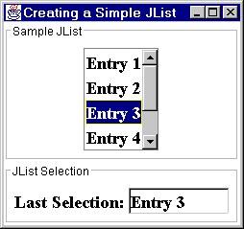
JList
A Jlist presents the user with a group of items, displayed in one or more columns, to choose from. Lists can have many items, so they are often put in scroll panes.
In addition to lists, the following Swing components present multiple selectable items to the user: combo boxes, menus, tables, and groups of check boxes or radio buttons. To display hierarchical data, use a tree.

Slide 202
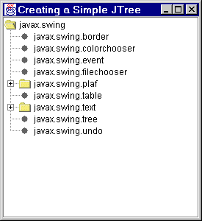
JTree
The simplest and most common way to use JTree is to create objects of type DefaultMutableTreeNode to act as the nodes of the tree.
Nodes that have no children will be displayed as leaves. we supply a value, known as the "user object", to the DefaultMutableTreeNode constructor, to act as the value at each node.
The toString method of that user object is what is displayed for each node.
Once we have some nodes, we hook them together in a tree structure via parentNode.add(childNode).
Finally, we pass the node to the JTree constructor.
Note that, since trees can change size based upon user input (expanding and collapsing nodes), trees are usually placed inside a JScrollPane.

Slide 203
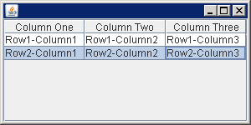
JTable
The JTable is used to display and edit regular two-dimensional tables of cells
With the JTableclass you can display tables of data, optionally allowing the user to edit the data.
JTable does not contain or cache data; it is simply a view of your data. Here is a picture of a typical table displayed within a scroll pane.

Slide 204
Layout Management (cont)
The Java platform supplies five commonly used layout managers:
BorderLayout
BoxLayout
FlowLayout
GridLayout
GridBagLayout

Slide 205
Layout Management (cont)
When using the add method to put a component in a container, the container’s layout manager must be taken into account.
Relative position (BorderLayout)
panel.add(component, BorderLayout.CENTER);
Order of addition (BoxLayout, GridLayout, ...)
panel.add(component);

Slide 206

BorderLayout
Has five areas available to hold components
north, south, east, west and center
All extra space is placed in the center area
Only the center area is affected when the container is resized.
Default layout manager of content panes.

Slide 207
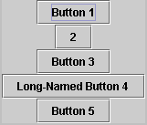
BoxLayout
Places components in a single row (left to right) or column (top to bottom).
Respects component’s maximum size and alignment hints.

Slide 208
FlowLayout
Places components from left to right, starting new rows if necessary.
Default LayoutManager of JPanel

Slide 209

GridLayout
Places components in a requested number of rows and columns.
Components are placed left-to-right and top-to-bottom.
Forces all components to be the same size
as wide as the widest component's preferred width
as high as the highest component’s preferred height

Slide 210
Layout Management (cont)
The following factors influence the amount of space between visible components in a container:
Layout manager
automatically, user specified, none
Invisible components
often used with BoxLayout
Empty borders
works best with components that have no default border such as panels and labels.

Slide 211

Events Handling
GUI application are event driven.
The event handling is based on event deligation model that comrises three parts:
(1)An event source
(2)The event
(3)The event handler/listener
Every time a user types a character or pushes a mouse button, an event occurs.
Any object can be notified of an event by registering as an event listener on the appropriate event source.
Multiple listeners can register to be notified of events of a particular type from a particular source.

Slide 212
Types of Event Listeners
Act that results in event | Listener type
User clicks a button, presses Return while typing in a text field, or chooses a menu item | ActionListener
User closes a frame (main window) | WindowListener
User presses a mouse button while the cursor is over a component | MouseListener
User moves the mouse over a component | MouseMotionListener
Component becomes visible | ComponentListener
Component gets the keyboard focus | FocusListener
Table or list selection changes | ListSelectionListener

Slide 213
Implementing an Event Handler
Implement a listener interface or extend a class that implements a listener interface.
Register an instance of the event handler class as a listener upon one or more components.
Implement the methods in the listener interface to handle the event.

Slide 214
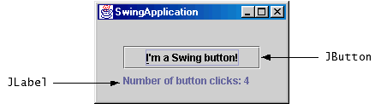
Example
button.addActionListener(new ActionListener() {
public void actionPerformed(ActionEvent e) {
numClicks++;
label.setText(labelPrefix + numClicks);
}});

Slide 215
Thank You
~Queries
~Suggestions

Slide 216
References
http://docs.oracle.com
http://j2eereference.com
http://google.com
Mc Graw Hill - SCJP Sun Certified Programmer for Java 6 Exam.

